Slide 1


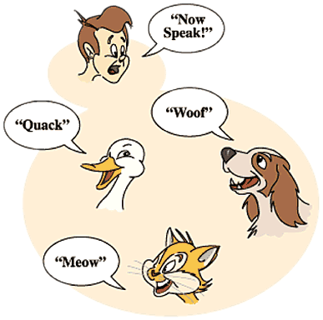

Polymorphism
Abstract Classes, Abstract Methods, Override Methods
Java OOP
Basics
SoftUni Team
Technical Trainers
Software University
http://softuni.bg

Slide 2

Table of Contents
Polymorphism
Abstract Classes
Abstract Methods
Override Methods

Slide 3
Questions
sli.do #7332

Slide 4
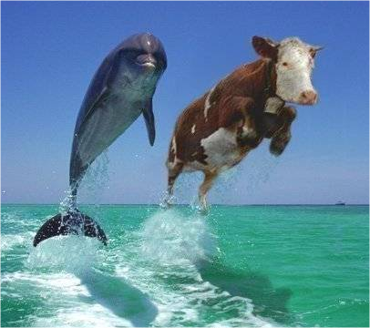
Polymorphism

Slide 5
Polymorphism
Polymorphism is the ability
to take on many forms
Notes:
Polymorphism is the ability of an object to take on many forms. The most common use of polymorphism in OOP occurs when a parent class reference is used to refer to a child class object.

Slide 6
Polymorphism Usage
A child class may override (change)
some of the parent's methods

Slide 7
Polymorphism Usage - Example
public abstract class Animal { } public class Deer extends Animal { } public class Elephant extends Animal { }

Slide 8
Polymorphism Usage – Example(2)
Creating instance of Deer as Vegetarian
Animal babyDeer = new Deer(); Animal babyElephant = new Elephant();

Slide 9
Why Polymorphism
To mix different data types in the same collection
Notes:
Demo (look at View -> Notes Page)
public static void main(String[] args) {
Vegetarian babyDeer = new Deer();
Vegetarian babyElephant = new Elephant();
List<Vegetarian> vegetarianAnimals = new ArrayList<>();
vegetarianAnimals.add(babyDeer);
vegetarianAnimals.add(babyElephant);
}

Slide 10
Why Polymorphism
instead of:
public static void call(Animal deer) { }
public static void call(Deer deer) { }
Notes:
To pass more specific object to method

Slide 11
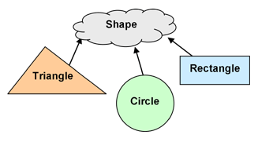
Abstract Classes

Slide 12
Abstract Classes
Abstract classes cannot be instantiated
Notes:
But they can be subclassed.

Slide 13
Abstract Classes (2)
An abstract class may or may not
include abstract methods.

Slide 14
Abstract Methods
public abstract class GraphicObject {
abstract void draw(); }

Slide 15
Abstract Classes - Purpose
They function as base classes
which can be extended

Slide 16
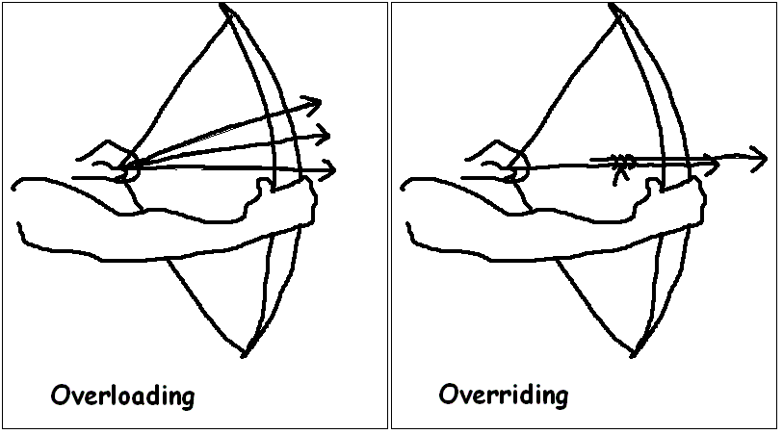
Override Methods
Notes:
The ability of a subclass to override a method allows a class to inherit from a superclass whose behavior is “close enough” and then to modify behavior as needed.

Slide 17
Overriding Methods - Rules
The argument list should be exactly the same
as that of the overridden method.

Slide 18
Overriding Methods – Rules (2)
The access level cannot be more restrictive
than
the overridden method's access level.

Slide 19
Overriding Methods – Rules (3)
A method declared final cannot be overridden.

Slide 20
Overriding Methods – Rules (4)
A method declared static cannot
be overridden but can be re-declared.
Notes:
A subclass within the same package as the instance's superclass can override any superclass method that is not declared private or final.

Slide 21

Summary
Polymorphism
Abstract Classes
Abstract Methods
Override Methods

Slide 22








Polymorphism
https://softuni.bg/java-basics-oop

Slide 23

License
This course (slides, examples, demos, videos, homework, etc.) is licensed under the "Creative Commons Attribution-NonCommercial-ShareAlike 4.0 International" license
Attribution: this work may contain portions from
"Fundamentals of Computer Programming with Java" book by Svetlin Nakov & Co. under CC-BY-SA license
"OOP" course by Telerik Academy under CC-BY-NC-SA license

Slide 24






Free Trainings @ Software University
Software University Foundation – softuni.org
Software University – High-Quality Education, Profession and Job for Software Developers
softuni.bg
Software University @ Facebook
facebook.com/SoftwareUniversity
Software University @ YouTube
youtube.com/SoftwareUniversity
Software University Forums – forum.softuni.bg

